Slide 1
MustangWiki Search Engine
CSE 2341 - Data Structures
Semester Project Overview

Slide 2
Scenario
MustangWiki's search engine is broken!
MustangWiki is a collaborative, open place where students, faculty, staff and the community can create online, freely-accessible content.
Please help MustangWiki get its search abilities back by implementing a fast search engine for all of the books in the collection.

Slide 3
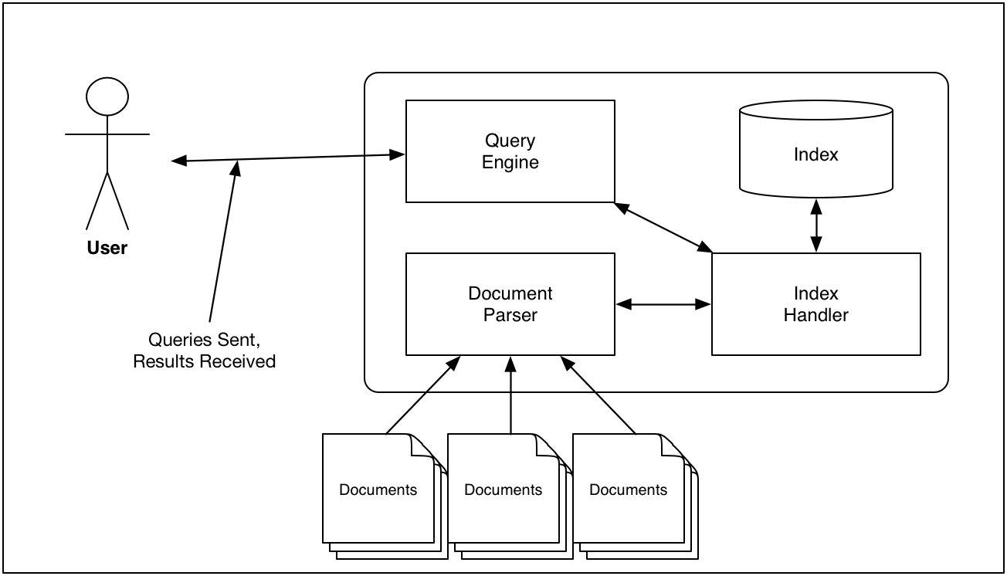
System Architecture

Slide 4
Sample Document
<page>
<title>Human Anatomy/Osteology/Axialskeleton</title>
<ns>0</ns>
<id>181313</id>
<revision>
<id>1481605</id>
<parentid>1379871</parentid>
<timestamp>2009-04-26T02:03:12Z</timestamp>
<contributor>
<username>Adrignola</username>
<id>169232</id>
</contributor>
<minor />
<comment>+Category</comment>
<sha1>hvxozde19haz4yhwj73ez82tf2bocbz</sha1>
<text xml:space="preserve">[[Image:Axial_skeleton_diagram.svg|thumb|240px|right|Diagram of the axial skeleton]]
The Axial Skeleton is a division of the human skeleton and is named because it makes up the longitudinal ''axis'' of the body. It consists of the skull, hyoid bone, vertebral column, sternum and ribs. It is widely accepted to be made up of 80 bones, although this number varies from individual to individual.
[[Category:{{FULLBOOKNAME}}|{{FULLCHAPTERNAME}}]]</text>
</revision>
</page>

Slide 5
Inverted File Index
Data structure for maintaining terms and a list of documents in which those terms appear.
Documents:
d1 = computer network security
d2 = network cryptography
d3 = database security
Index:
computer = d1
network = d1, d2
security = d1, d3
cryptography = d2
database = d3

Slide 6
Document Parser
the
a
nicely
running
running
formed
Remove Stop
Words
running
nicely
formed
Stem
run
nice
form

Slide 7
Query Processor
Will handle simple prefix Boolean queries
no nesting
Either AND or OR
May include NOT (all NOTs will be trailing)
Examples:
Seattle
Seattle NOT Boston
AND book food bank
OR Boston Seattle
AND Book Boston NOT Seattle

Slide 8
Index Handler
Creation and maintenance of inverted file index.
Search and returning documents containing a specific word (query term)
May maintain other information such as frequency of word appearance.

Slide 9
Inverted File Index Implementation
You'll implement at least two underlying data structures to maintain the inverted file index
AVL Tree
Hash Table
Classes that will be used to store index should implement the same interface.
may be adapters to AVL or hash table.
Index should be persistent.
When program starts, user should have the option of importing index into AVL or Hash table.

Slide 10
Ranking the Results
Ranking will be done using Term Frequency/Inverse Document Frequency (TF/IDF) statistic.
General Idea:
If a word appears in a document frequently, but appears rarely in other documents from the same corpus, it is important result for the query.
If a word appears in a document but also appears in many other documents, it is less important.

Slide 11
User Interface
3 modes:
maintenance mode
add to the index; clear the index
interactive mode
user can enter a query,
return ranked results
allow user to choose a page to view
stress test mode
allow user to submit a command file.
Commands are created by each group and documented

Slide 12
Project Mechanics
Can be done individually or in in teams of 2 or 3 students (max)
Teams of 3 have to implement basic date range queries and user/writer queries
Must use OOP
May use as much of c++ std lib as you'd like
Code base should be properly documented and formatted.

Slide 13
About the Dataset
Wikibooks export file
~171,000 individual pages (<page></page>)
>700 MB of raw
XML format
Not pretty
May contain non-ascii characters
Goal: Parse and index in under 2 minutes!

Slide 14
Suggestions
This is a gigantic project
May contain > 20 classes all working together
You have to start NOW!
Spend up-front time on design!
Implement one piece at a time.
Once that works and is tested, back it up.
Think about versioning of software.
0.1, 0.2, 0.3...
Make an initial list of goals for each version and when they should be done.

